Slide 1
CSE 4300 Project
By Ethan Gurry

Slide 2
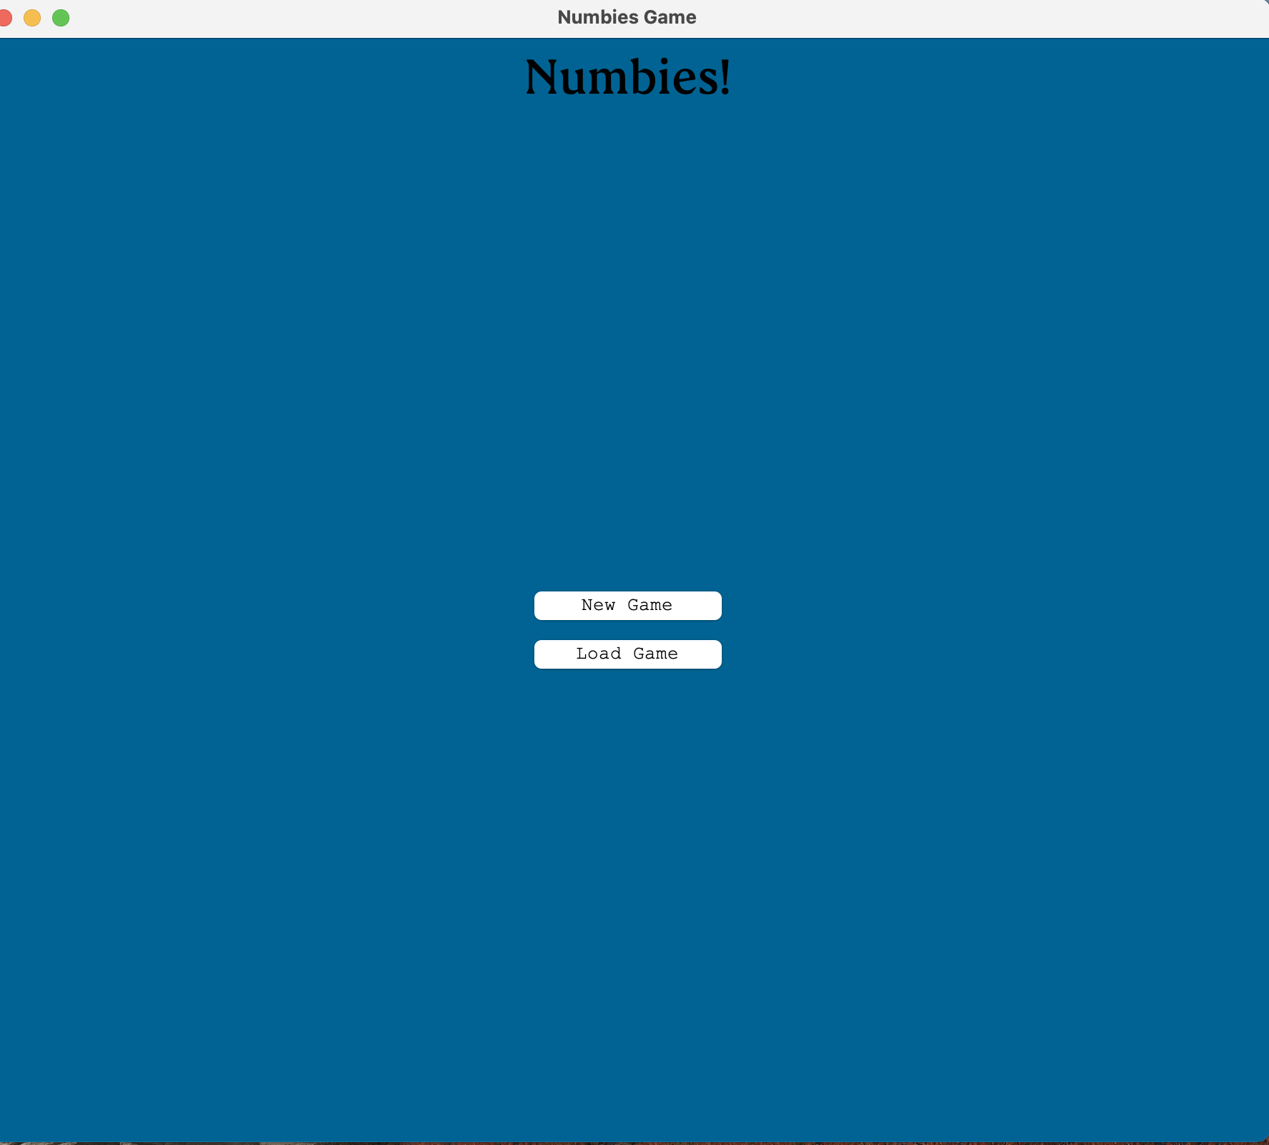
Number Guessing Game
Called numbies
Created the idea with brother and friends
Originally played with chalkboard
Made it up around 5 years ago

Slide 3
Game Overview/Rules
1 player called gamemaster picks a number
Number of guesses per player are determined by number of digits in the gamemaster’s number
Points possible depends on digits
Gamemaster responds up or down to each guess
Last guess is special
Guess one digit at a time
gamemaster responds yes or no to each digit

Slide 4
Design
Created with java and java swing in intellij IDEA
Classes
Player
Name, score
Game
Calculate points
Determine turns
Change order of players
Make guess
SaveFile
Save
load

Slide 5
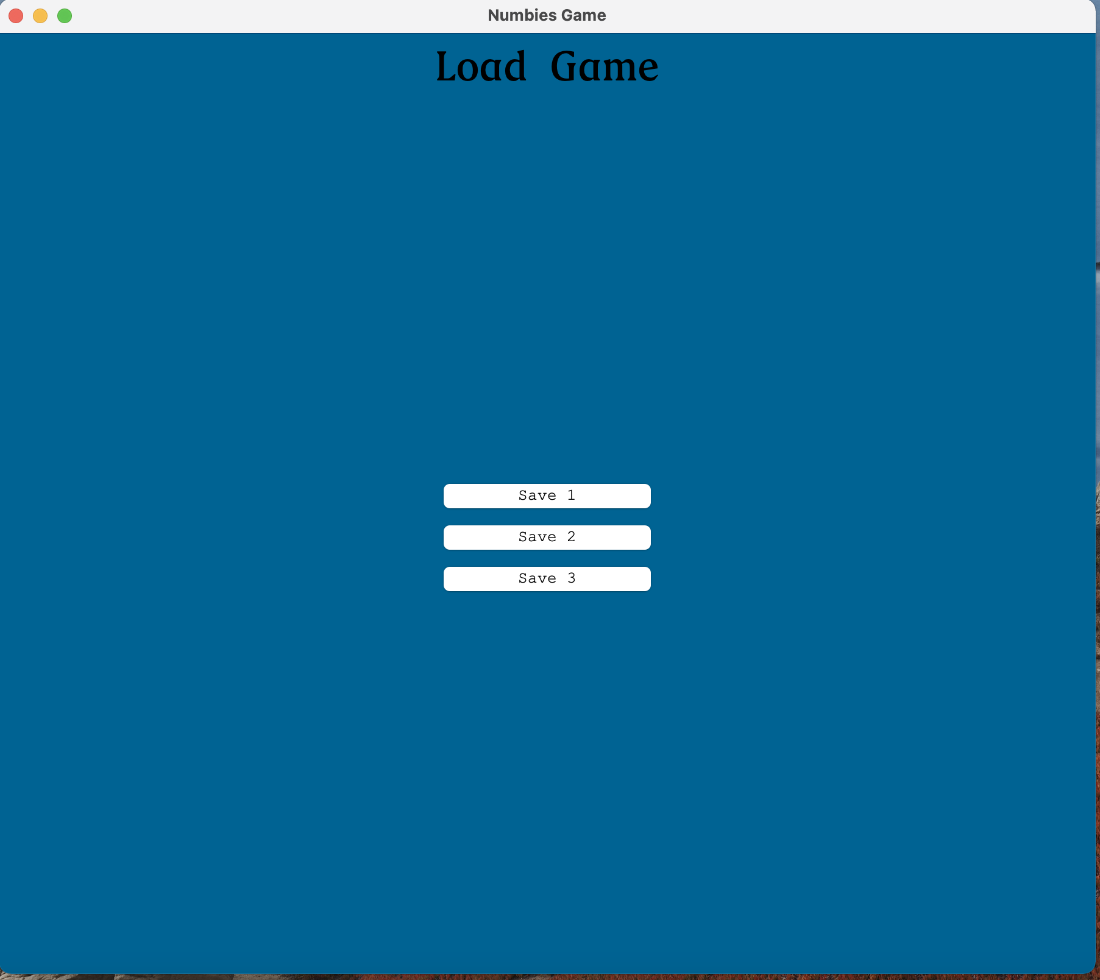
Load Screen

Slide 6
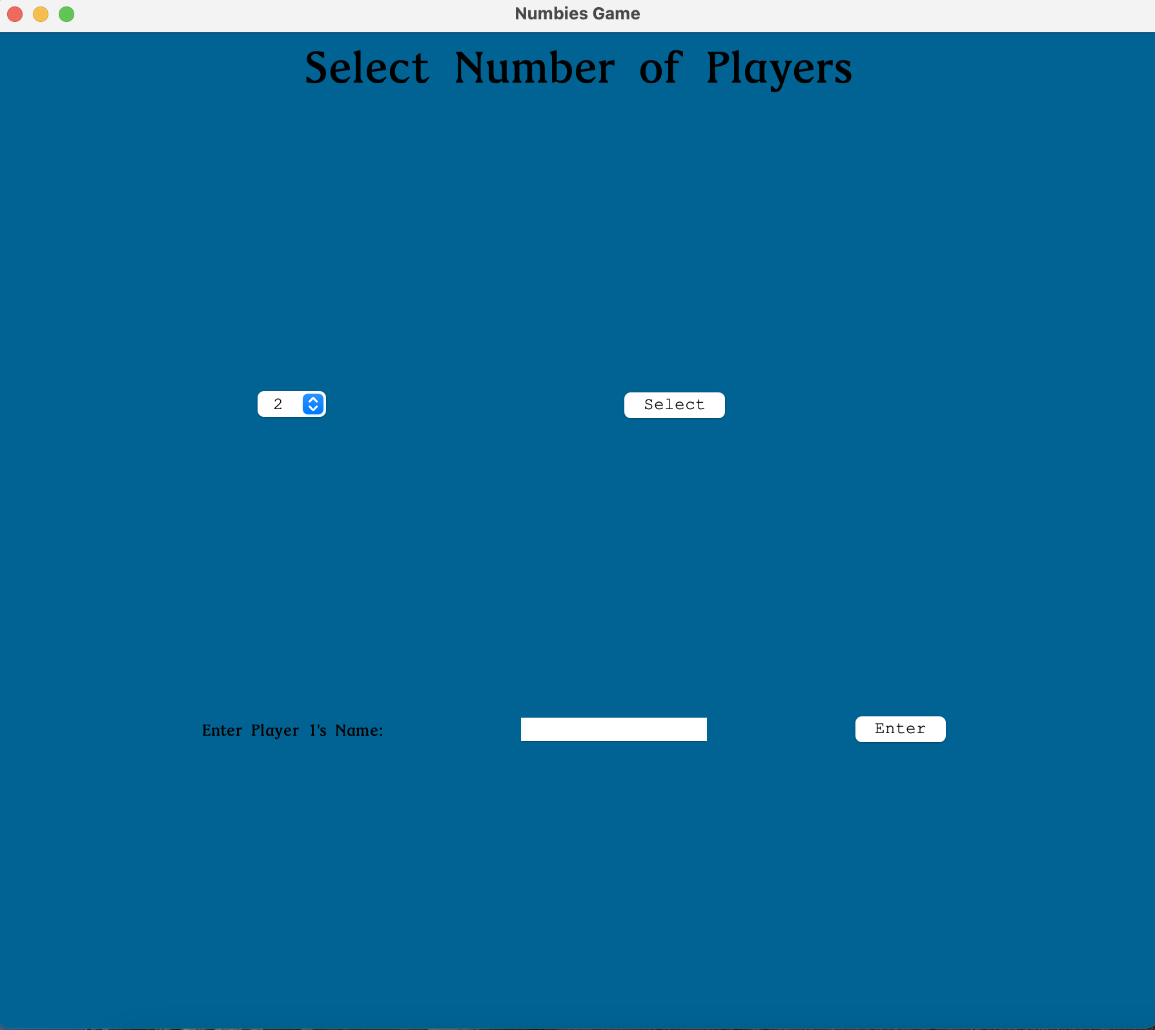
New Game

Slide 7
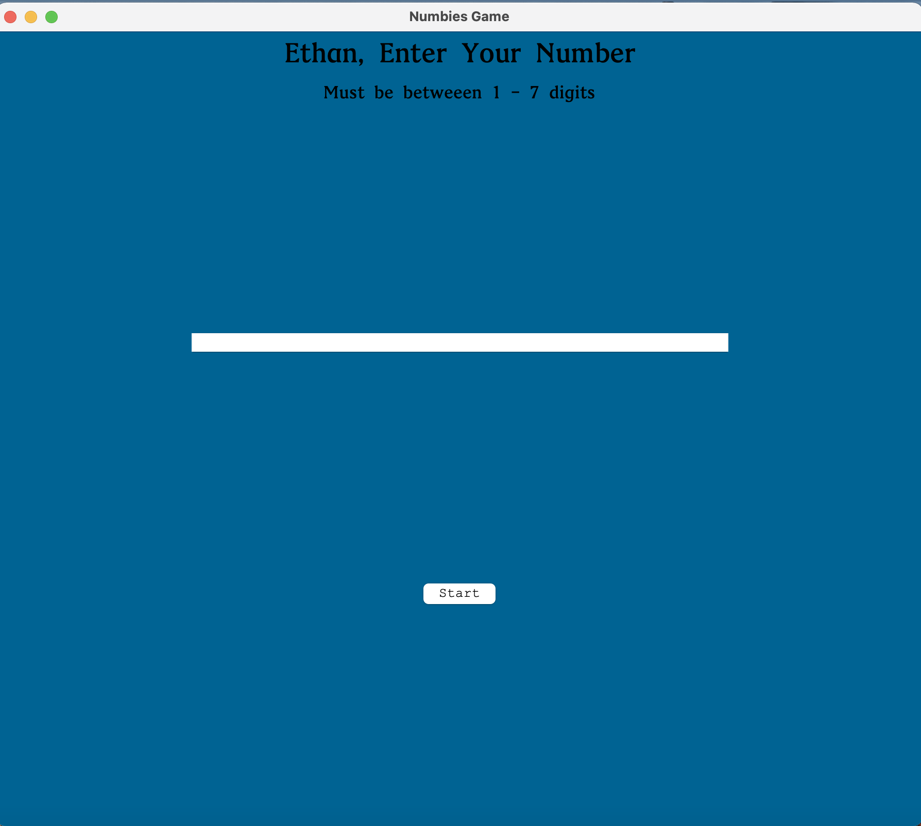
Gamemaster Screen

Slide 8
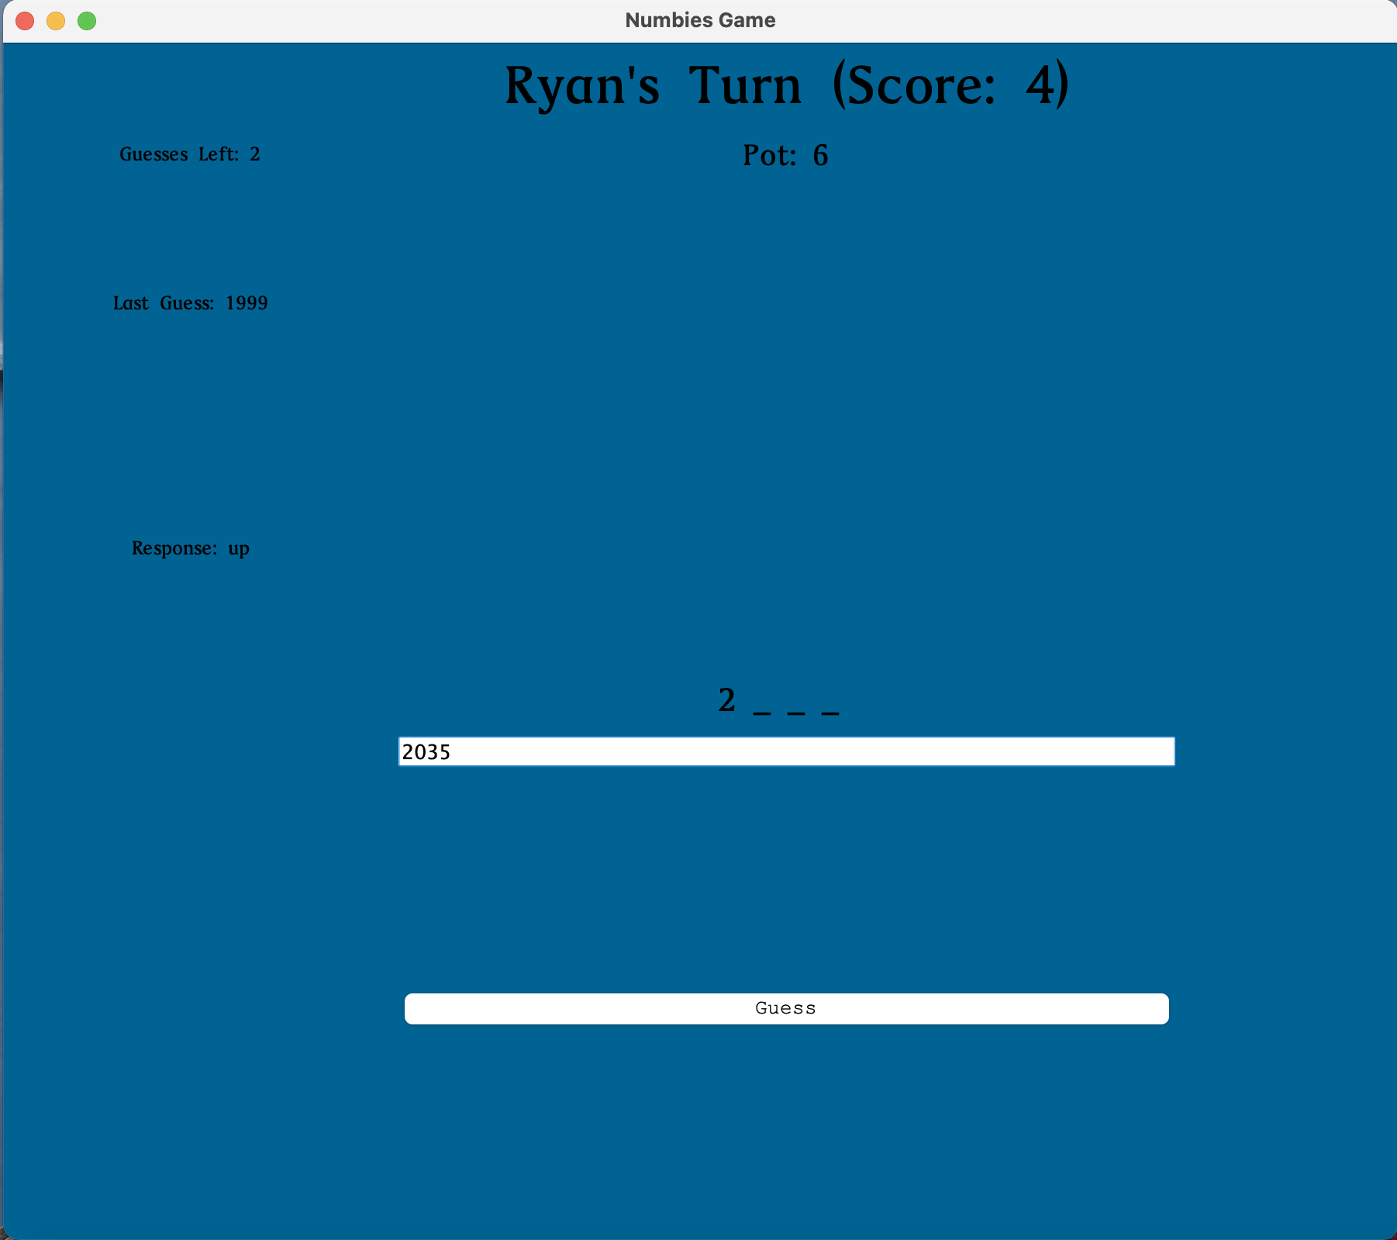
Game Board
Add to guesses
Reveal Digit

Slide 9
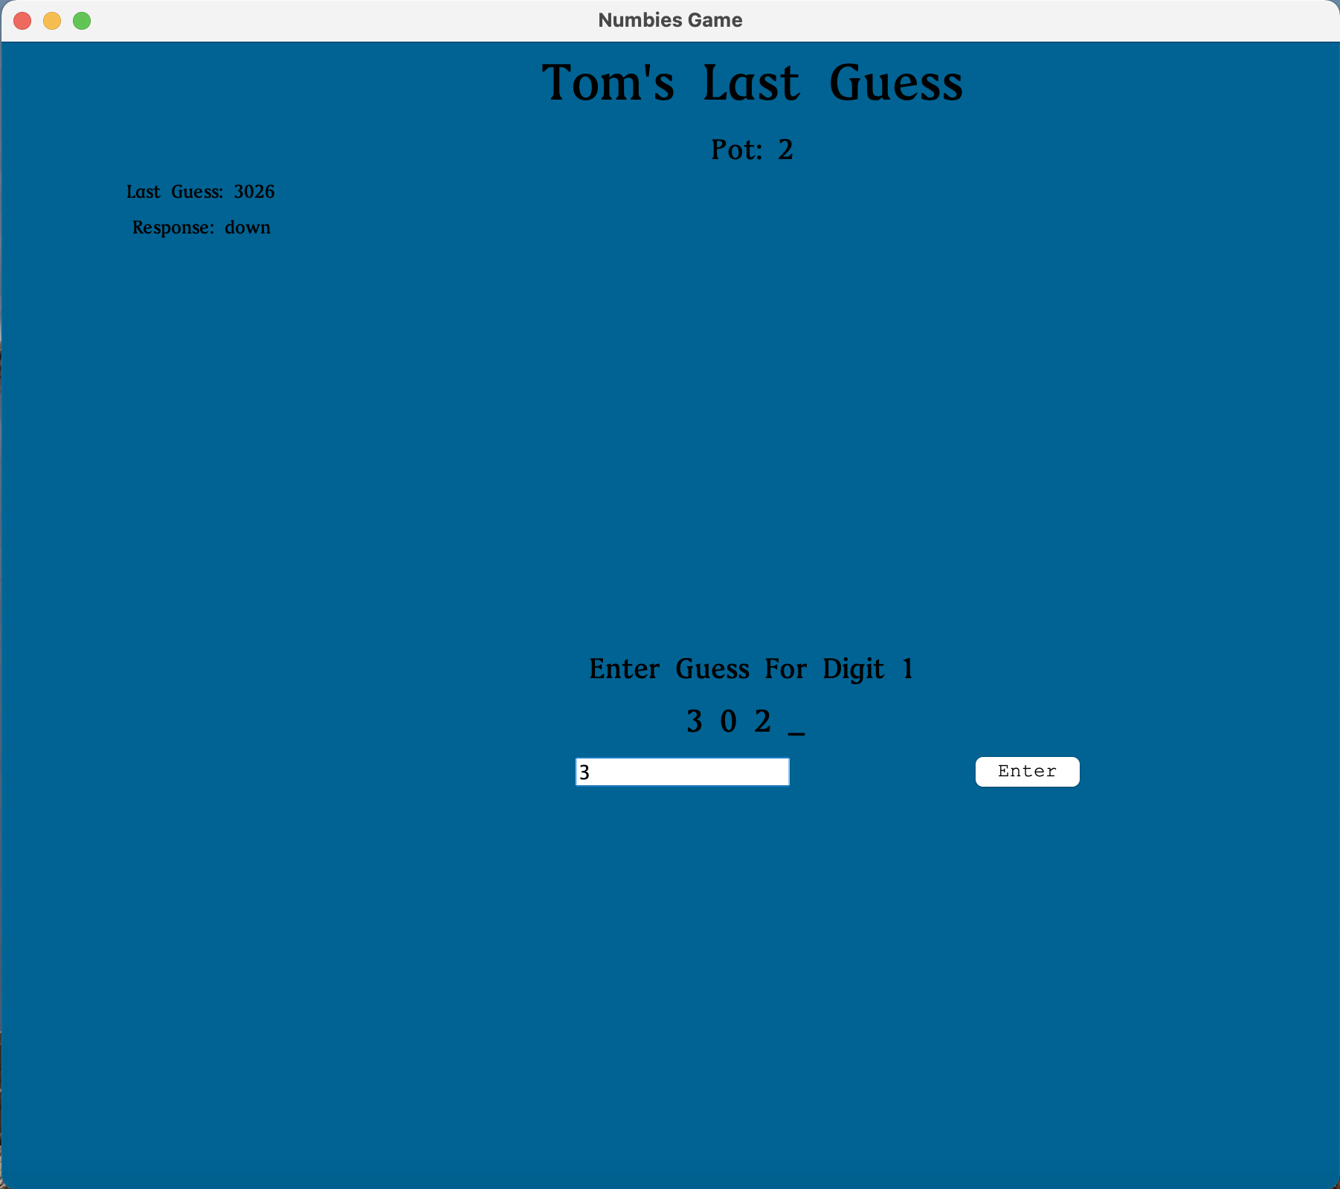
Last Guess
Used a lot of the same logic as game board

Slide 10
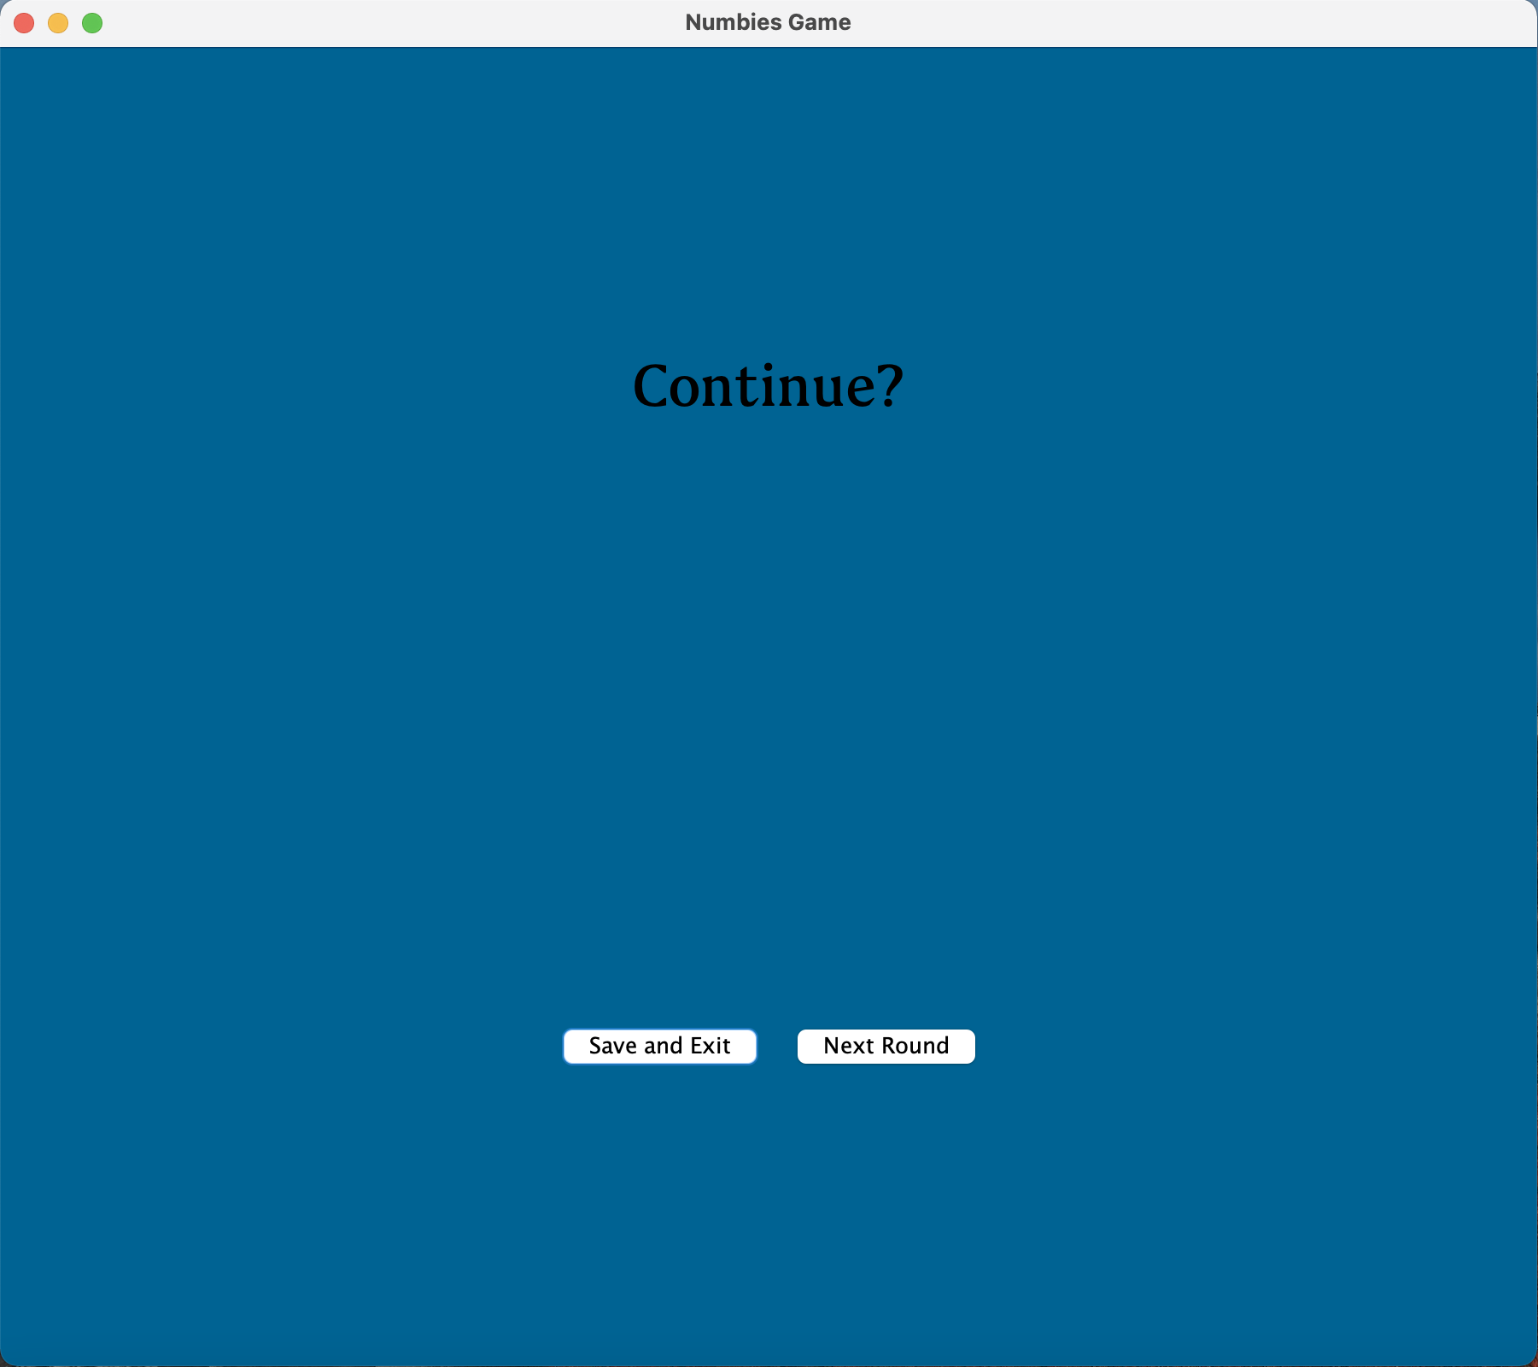
Continue Screen

